Slide 1
Chap 3: CBR
FSKKP, UMP
BCS2313: Artificial Intelligence Techniques

Slide 2
What You’ll Learn
Into to Knowledge Discovery in Databases (KDD) & Learning Algorithm
Case-Based Reasoning (CBR)
Overview of CBR
CBR Cycle & System
Similarity in CBR
Case-based vs. Rule Base Expert System: Knowledge Representation
Type of Applications

Slide 3
KDD & Learning Algorithm

Slide 4
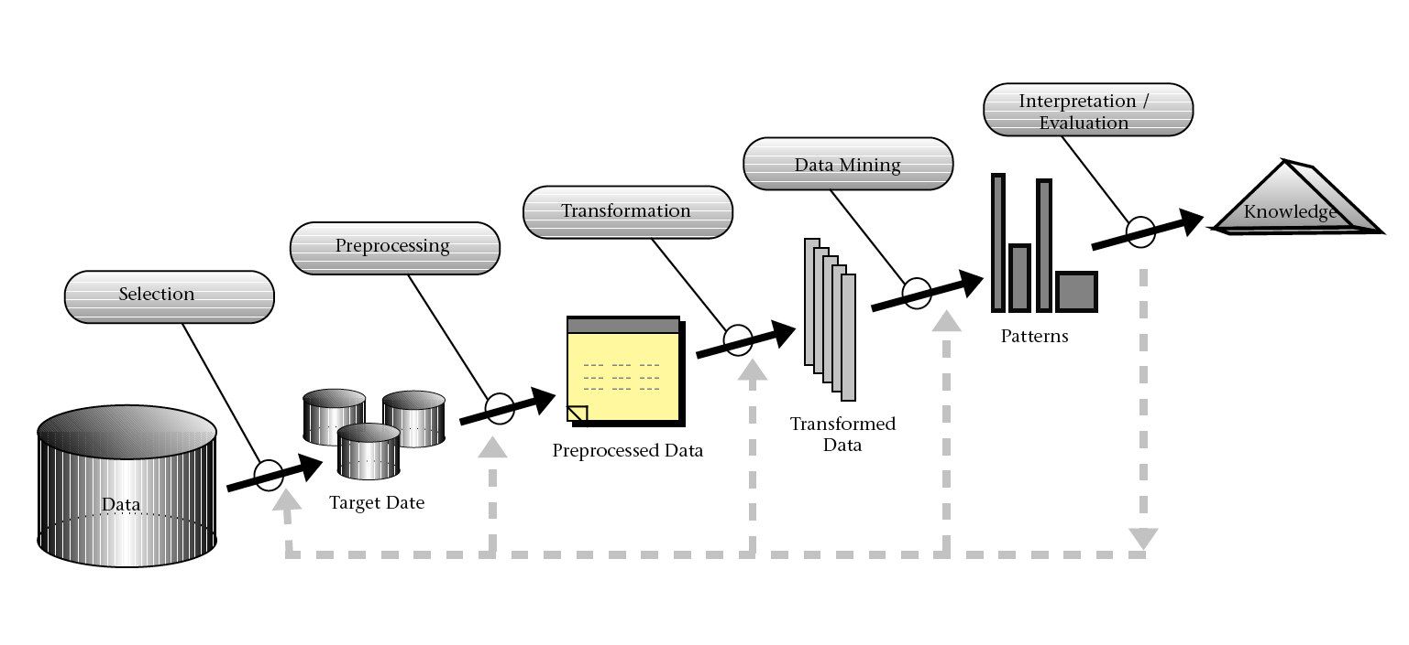
KDD Process
The Knowledge Discovery in Databases process (KDD) includes all processes needed for the development of AI, data mining research/project, its start with data selection to the result evaluation.
Source: Fayyad et al., 1996

Slide 5
KDD Process – Selection
Selection
Refers to the process of obtaining data for data mining process.
The data may come from different and heterogeneous data sources.
The data need to be selected before it can be an input for the data mining process (Dunham, 2003).
This steps is important in order to select only significant data that will be used for the entire study.

Slide 6
KDD Process – Preprocessing
Preprocessing
Once the target data has been determined, the raw data need to go through a data cleaning process.
This process treats the raw data into good and healthy data to fit into the classification process.
Processes include; replacing a missing data, correcting the noisy data and eliminating the unwanted attribute to ensure the classification process run smoothly and obtain a good quality result.

Slide 7
KDD Process – Transformation
Transformation
The aim for data transformation is quite similar to data pre-processing, that is to pledge a good input for the classification process.
This process involves converting or transforming the data into usable format.
Data from previous process (Processing) may be modified to facilitate usage by the selecting technique that requires specific data format. Some attributes values may be combined to produce new value; data reduction or converting data from discrete value to continuous value, or vice-versa.

Slide 8
KDD Process – Data Mining
Data Mining
The most important step in the KDD process.
The literal definition of data mining is “to uncover useful information from a large amount of data.”
The purpose of data mining is to extract interesting knowledge from a database, data warehouse, or some other large information storage unit.
Process of applying suitable algorithms to transform data into desired results.

Slide 9
KDD Process – Interpretation/Evaluation
Interpretation / Evaluation
This stage conveys the data mining result into understandable format to be used by users.
Discovered pattern must be clearly interpreted and evaluated to ensure the resulting information is clear and express the result straight to the end user without any misunderstanding.

Slide 10
Machine Learning
Machine learning, a branch of artificial intelligence, is a scientific discipline concerned with the design and development of algorithms that allow computers to learn based on empirical data, such as from sensor data or databases.

Slide 11
AI Learning Algorithms
Two main type of Learning Algorithms
Supervise Learning – generalize pattern based on dataset that consisting input and desire output
Un-supervise Learning – partitioning or segmenting data into group

Slide 12
CBR in Details..

Slide 13
What is Case-Based Reasoning (CBR)
Case-based reasoning means using old experiences to understand and solve new problems.
A case-based reasoner solves new problem by using or adapting solution that were used to solve old problems
Kolodner, 1992
www.ai-cbr.org

Slide 14
What is Case-Based Reasoning (CBR)
A case-based reasoning is a AI technique that imitates how human make a decision. In CBR, new problems are solve by recalling from previous solved problem which are store an the case-base
Aamodt & Plaza, 1994

Slide 15
What is Case-Based Reasoning (CBR)
AI technique that try to model/imitate human reasoning (decision making) and thinking
One of a method for building intelligent computer systems
It is a supervise learning algorithm – classes are determine before examining the data.
The input pattern is classified into one or several classes based on similarity to the predefine classes.
Cases are stored in the “case-base”

Slide 16
CBR in a nutshell..
Store previous experience (cases) in memory
To solve new problems:
Retrieve similar experience about similar situations from the memory
Reuse the experience in the context of the new situation: complete or partial reuse, or adapt according to differences
Store new experience in memory (learning)

Slide 17
What is Case(s)..
A case describe one particular diagnostic situation
Case(s) have two main components:
Specification (SP): set of attributes (features) and values – represent particular case or problem and it should have unique characteristic.
Solution (SL): the case solution, represent the problem solving for such case.
Collection of cases are call “CASE-BASE”

Slide 18
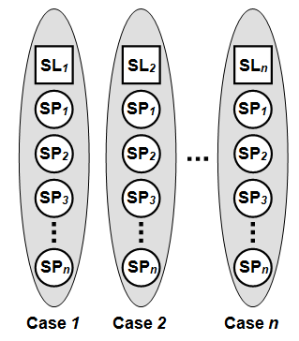
What is Case(s)..
Cases’ Components: relation between SP and SL

Slide 19
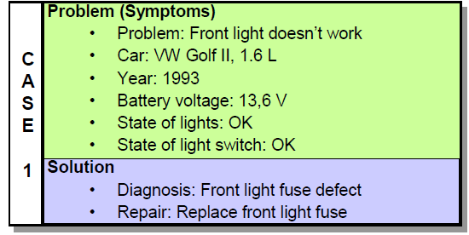
Example of Case..
Car diagnostic situation
Attribute
Value
Decision

Slide 20
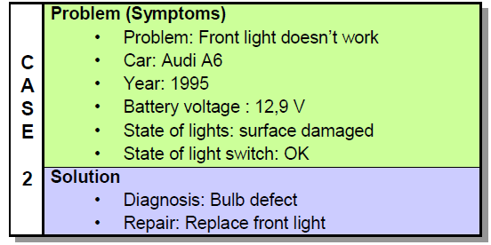
Example of Case-Base..
Case-base with two cases
Each case describe one particular situation
All cases are unique from each other

Slide 21
Solving a New Diagnostic Problem.
A new problem must be solve.
The new problem is a case without the solution part.
Attribute
Value
Problem (Symptom):
Problem: Break Light doesn’t work
Car: Audi 80
Year: 1989
Battery voltage: 12.6 V
State of light: OK

Slide 22
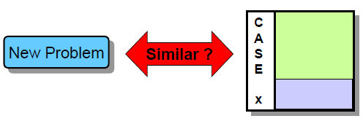
How to Find Solution??
Rank the cases according their similarities
Similarities is the most important concept in CBR
We can assess similarity based on the similarity of each attributes (features)
Similarity of each attributes (features) depends on the attribute's VALUE

Slide 23
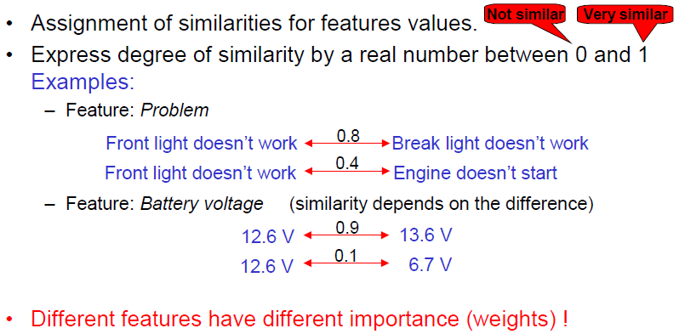
Similarity Computation

Slide 24
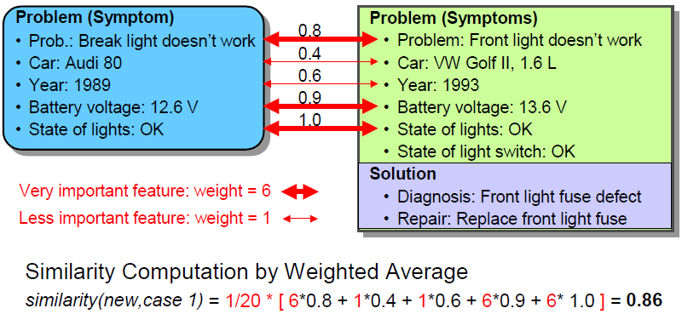
Compare New Prob. to Case 1

Slide 25
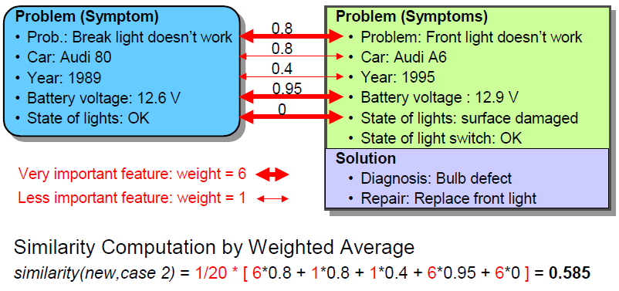
Compare New Prob. to Case 2

Slide 26
So the Solution??
New problem similar to Case 1 = 0.86
New problem similar to Case 2 = 0.585
Case 1 is more similar to the new problem!

Slide 27
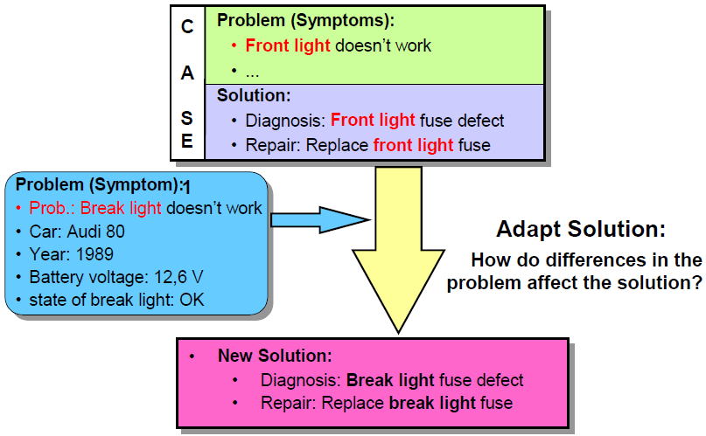
Reuse the Solution of Case 1

Slide 28
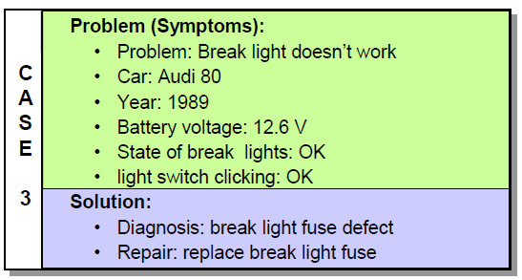
Store the New Solution
If the diagnosis is correct: Store it to the case-base

Slide 29
CBR Cycle

Slide 30
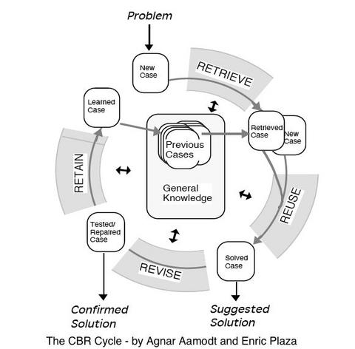

Slide 31
CBR Cycle
RETRIEVE
find similar
problems
RETAIN
integrate in
case-base
CBR
REUSE
propose solutions
from retrieved cases
REVISE
adapt and repair
proposed solution

Slide 32
Case Retrieval

Slide 33
What is Case Retrieval?
Usually regarded as the most important in CBR cycle
Various approach have been developed to retrieve similar cases in CBR
Similarity measure are used in the CBR retrieval process
Poor reasoning resulted from poor similarity measure

Slide 34
What is Similarity measure?
Similarity measure is used in problem solving and reasoning to match a previous experience/case (case-base) with the new unseen problem to find solution.
It is the heart of CBR system!
Can be call as case matching in CBR – match new case with the previous cases from the case-base to find solution.

Slide 35
What is Similarity measure?
Purpose of similarity:
Select cases that can be adapted easily to the current problem
Select cases that have (nearly) the same solution than the current problem
Basic assumption: similar problems have similar solutions
Goal of similarity modeling: provide a good approximation

Slide 36
Similarity..
There are two type of similarity:-
Local Similarity
Used to compute the similarity between query (new problem) and case attributes values – feature level
Global Similarity
Global similarity is a build up from number of local similarity function. It is a weight sum of the local similarity – case/object level

Slide 37
Similarity..
The similarity measurement for local similarity is calculate between each attributes values, while Global Similarities is calculated between each cases.
Relationship between Local (SL) & Global Similarities
Global Similarity
LS 2
LS 3
LS 1
LS 4
LS n

Slide 38
Local Similarity..
Similarity between two cases is based on local similarity between each case attributes values (feature)
There are two type of local similarity formula:-
Numerical/Continuous value
Discrete value

Slide 39
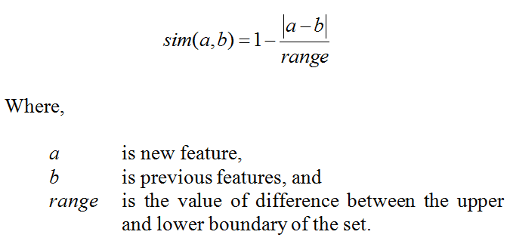
Local Similarity – Continuous
The formula is:-

Slide 40
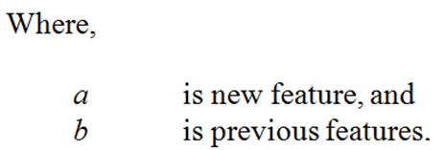

Local Similarity – Discrete
The formula is:-
$$sim \left(a,b\right)= \left\{\begin{aligned} 1 if a=b \\ \\ 0 if a≠b \end{aligned}\right.$$

Slide 41
Global Similarity..
After a set of local similarities have been calculated for each feature in the case, a global similarity will be calculated.
Global similarity provides a case-matching behavior using the global similarity calculation to find the relationship between two cases.
There are many formula available – Weight Block-City formula

Slide 42
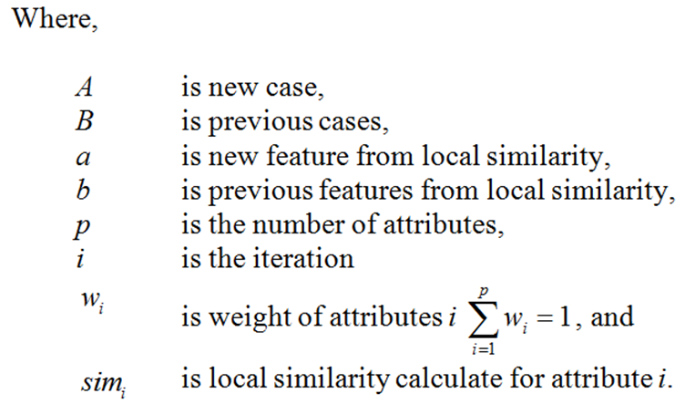
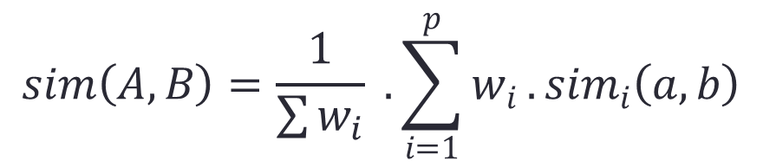
Global Similarity..
$$sim\left(A,B\right)=\frac{1}{\sum{w_{i}}} . \sum_{i=1}^{p}{w_{i}}.{sim}_{i}\left(a,b\right)$$

Slide 43
Reuse

Slide 44
How to Adapt the Solution
Different option available:-
No modification of the solution: just copy
Manual/interactive solution adaptation by the user
Automatic solution adaptation
Transformational Analogy: transformation of the solution
Derivational Analogy: replay of the problem solving trace
Compositional adaptation: combine several cases to a single solution

Slide 45
Revise

Slide 46
Verification & Correct Solution
Revise phase: little attention in CBR research today
No revise phase
Verification of the solution by computer simulation
Verification / evaluation of the solution in the real world
Criteria for revision
Correctness of the solution
Quality of the solution
Other, e.g., user preferences

Slide 47
Retain

Slide 48
Learning from Solve Problem
What can be learned:
New experience (new case)
Improved similarity assessment, importance of features
Organization/indexing of the case base to improve efficiency
Knowledge for solution adaptation
Forgetting cases, e.g., for efficiency or because out-of-date
Methods:
Storing cases in the case-base
Deleting cases from the case-base

Slide 49
Advantages/Disadvantages

Slide 50
Advantages/Disadvantages of CBR
Advantages
Reduces the knowledge accusation effort – Knowledge-Based System
White-box learning – explanation facilities
Incremental learning
Closer match to human reasoning
Makes use of existing data, e.g. in database
Disadvantages
Lazy learning algorithm

Slide 51
Reduces Knowledge Accusation Effort
Domain expert is unwilling to participate in knowledge eliciting process due lack of understanding of the technology – technology gap.
Knowledge engineer finds difficulty in communicating with the domain expert/experts because knowledge engineer initially has less domain knowledge than the domain expert – knowledge gap.
Correctness of the rule–base developed can be questionable due to the knowledge gap between knowledge engineer and domain expert.

Slide 52
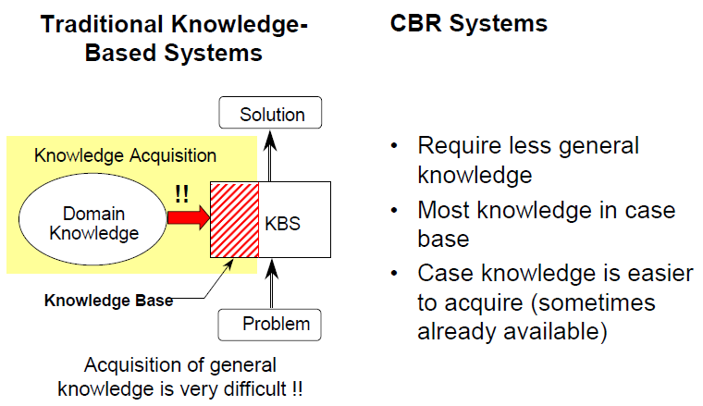
Reduces Knowledge Accusation Effort

Slide 53
Explanation Facilities
Explanation is a must to every intelligence system.
It is a way how user (human) can trust the reasoning done by the system.
The need of the explanation facilities is critical since the reasoning will be used in assisting the decision making process, giving advice or other contexts with potentially significant impact.
How it done? – CBR stores old experiences or cases in a memory known as case-base. This enable the algorithm to recall previous cases to solve a new problem. This process is called retrieval.

Slide 54
Incremental Learning
Incremental learning is an ability of a learning algorithm to incorporate new knowledge into existing knowledge to suite the available data.
Learning new data without forgetting prior knowledge is an issue in learning algorithm.

Slide 55
Lazy Learning
Generalization the training data is delayed until a query is made to the system
Usually slower to evaluate
Large space requirement to store the entire training dataset - Not suitable for large data

Slide 56
Applications

Slide 57
CBR Applications
Medical
Automatic monitoring wound healing
Computer
Traffic pattern recognition for 3G Networks
Education
Use intelligent tutoring systems (ITS) to improve of public health domain

Slide 58
Wound Healing System
This system utilize the capability of CBR in monitoring leg ulcers and this system is expected to reduce the workload of professional, time and money. For the normal operation, clinicians need to check the patient’s wound in regular basis to ensure the healing process is going fine. This automated wound healing system, will used images of the wound and take the RGB (red, blue and green) features histogram for the CBR classification. The outcome form this RGB features gave a 89.93% accuracy for the system.

Slide 59
Traffic Pattern Recognition
Chantaraskul and Cuthbert (2004) implement CBR as a part of an intelligent-based agent management system in managing the traffic congestion in 3G networks. This system used agent as a traffic pattern recognition in order to identify the specific type of problem and finally proposed a solution. CBR is introduced to give the agent to be more intelligence in automatically solve a problem by recognizing similar traffic pattern that the system has seen before, that has been stored in case library. The result shows the CBR was able to detect congestion occurrences and apply the appropriate solution to overcome it.

Slide 60
Intelligent Tutoring Systems
Gonzalez et al. (2005), used CBR as an engine for tutoring agent that is responsible in reasoning about the students behaviors, and to generate instructions plan that can be adapted to student needs. The e-learning system was use to provides a learning process and try to improve decision making process by using tutoring agent.

Slide 61
Summary

Slide 62
Summary
CBR is a technique that solve problem based on experience
CBR involve four phases/cycle
Retrieve Reuse Revise Retain
Similarity for matching OLD & NEW cases
Imitate how human make decision making
Have own advantages and disadvantages over other AI techniques

Slide 63
Next Class, What You’ll Learn
CO Cover: CO1 – Point out the artificial intelligence concept in computer science.
AI Topic: Chap 3 – Fuzzy Logic

Slide 64
Refference
[Fayyad et al., 1996] U. Fayyad, G. P.-Shapiro, and P. Smyth. From data mining to knowledge discovery in databases. AI Magazine, 17(3):37-54, Fall 1996

Slide 65
Q & A

